Slide 1
Fashion E-commerce Website

Slide 2
INTRODUCTION
The computers and computer applications are finding its voyage to each and every field of mankind, where the data and information are the primary necessities. The actual processing of the system becomes very useful to its users because manipulation and utilization of data in a meaningful way is the need of each and every organization.

Slide 3
MOTIVATION
The main objective of this project is to implement a computer based Online T-shirt Ordering System. This system will provide the users with a system to order all types of fashion T Shirts to wear, seamlessly. It will also help the users to know the latest offers of their interests. The database will be developed with open source.

Slide 4
scope
To develop a T-Shirt Ordering System.
To design an Order Management system.
To design a customer web management system interface which interacts with database system.
Leverage cutting edge technology as a competitive advantage.
Exceed customer expectations by offering high quality products at reasonable prices with quick turnaround times.
Employ careful financial and accounting analysis to ensure efficiency and proper controls.

Slide 5
FUNCTIONAL REQUIREMENTS
Server Operating System: Windows
Packages: Apache
DBMS: MySQL
Web Browser: Internet Explorer, Mozilla, Safari etc.
Internet Connection

Slide 6
NON-FUNCTIONAL REQUIREMENTS
Server machine should have a powerful CPU and high speed internet access so that it can handle multiple users at the same time.
Another performance requirement is the storage space.
Higher storage space means more user and bigger workspace per user so higher the storage, better the performance.
Product should be able to protect privacy of user data.

Slide 7
Features
Used md5 to encrypt the password.
Used mysqli_real_escape_string to prevent sql injection.
Used Local Storage of HTML5.
Local Storage along with JavaScript was used to implement Shopping Cart.

Slide 8
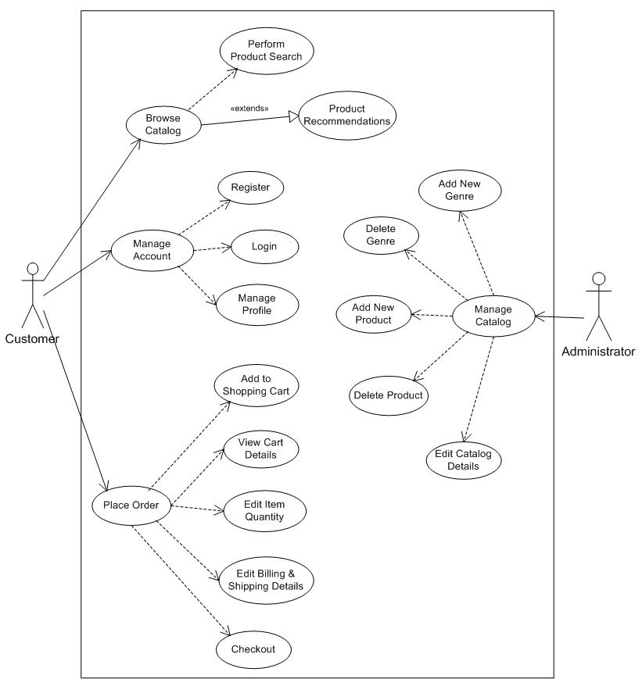
USE CASE DIAGRAM

Slide 9
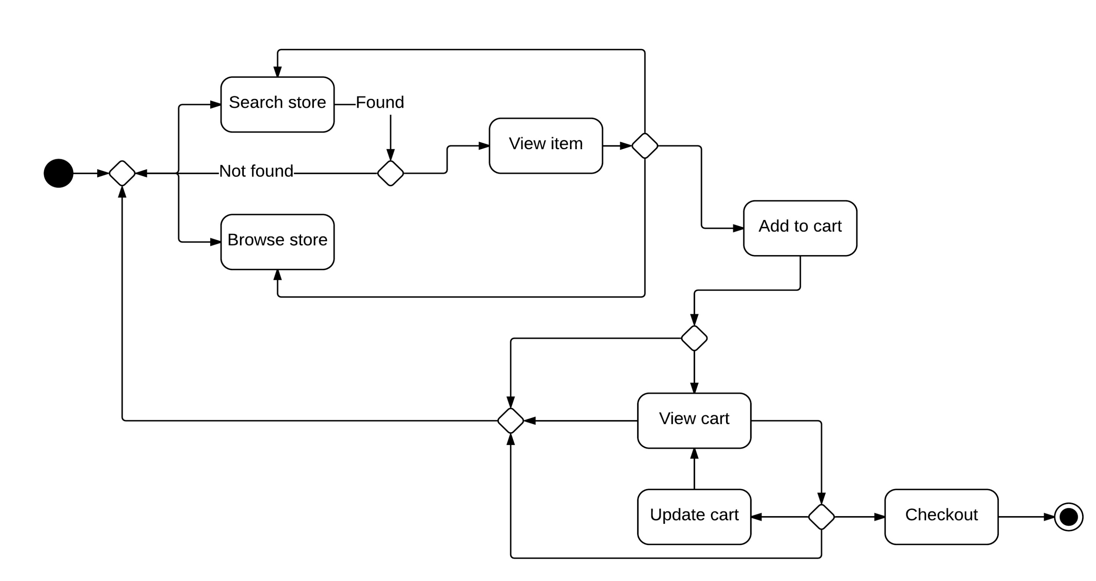
ACTIVITY DIAGRAM

Slide 10
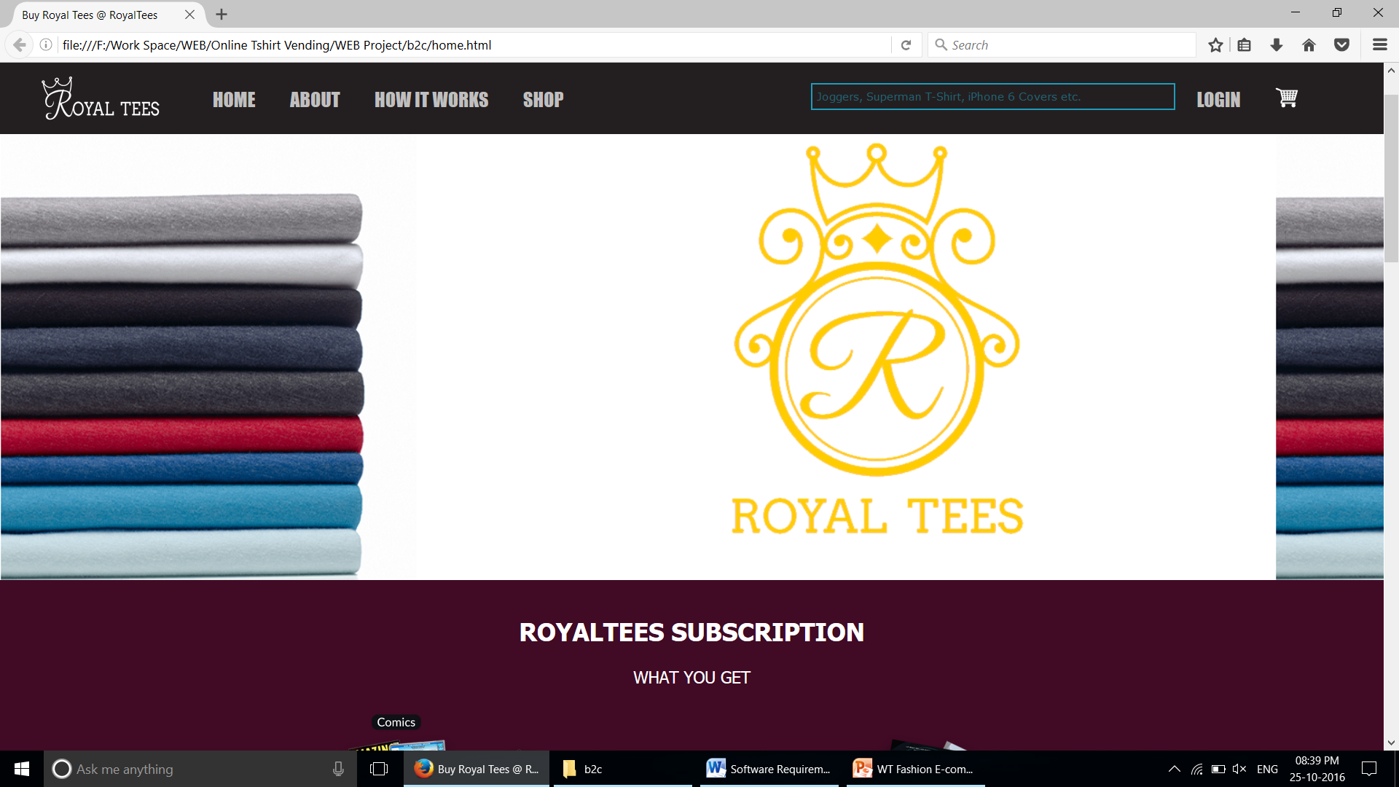
Website design - homepage

Slide 11
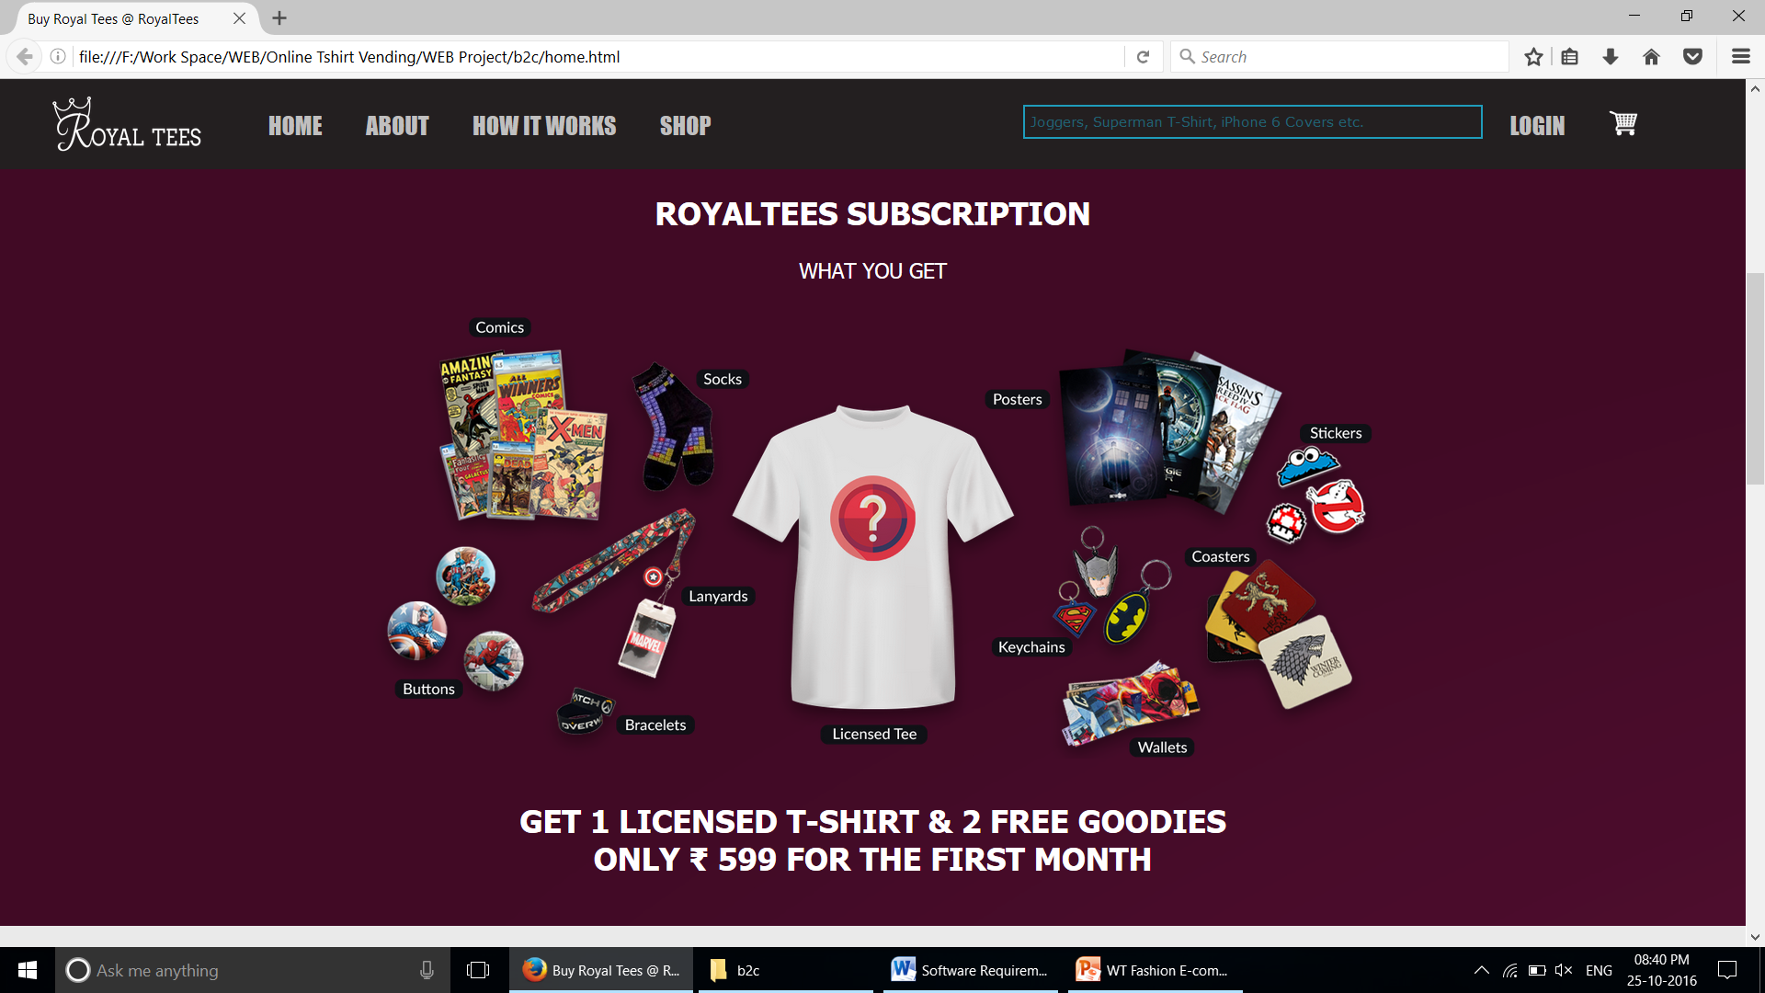
Website design – Subscription model

Slide 12
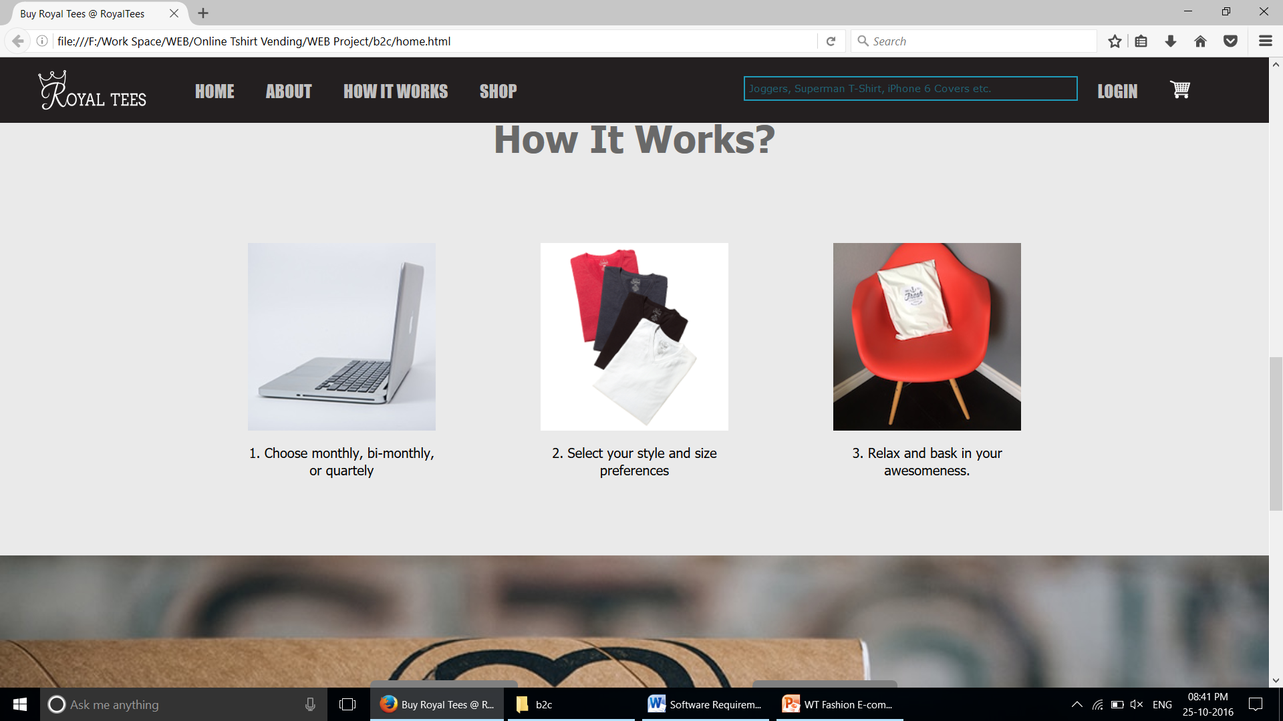
Website design – Subscribe or shop options

Slide 13
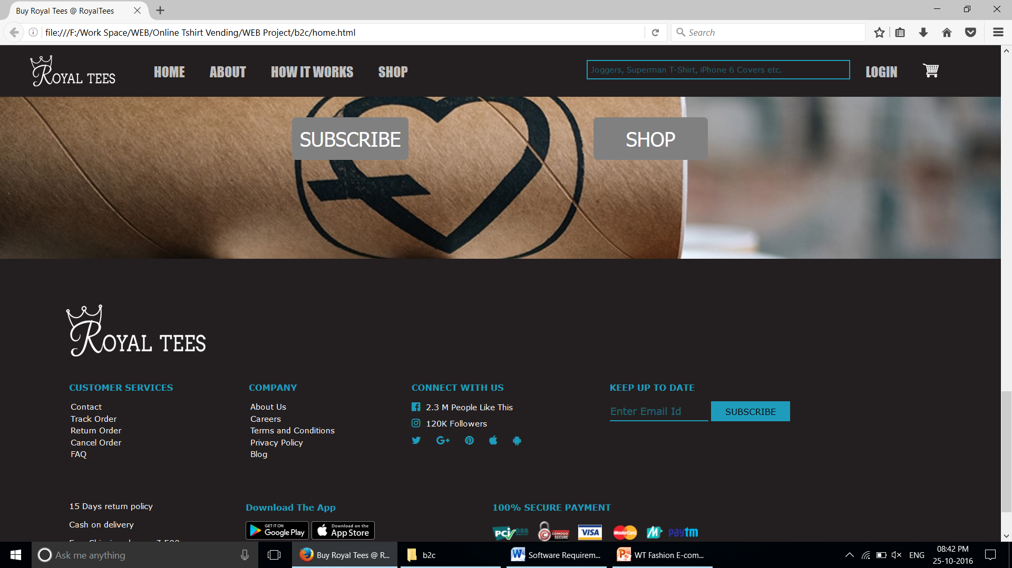
Website design – Subscribe or shop options

Slide 14
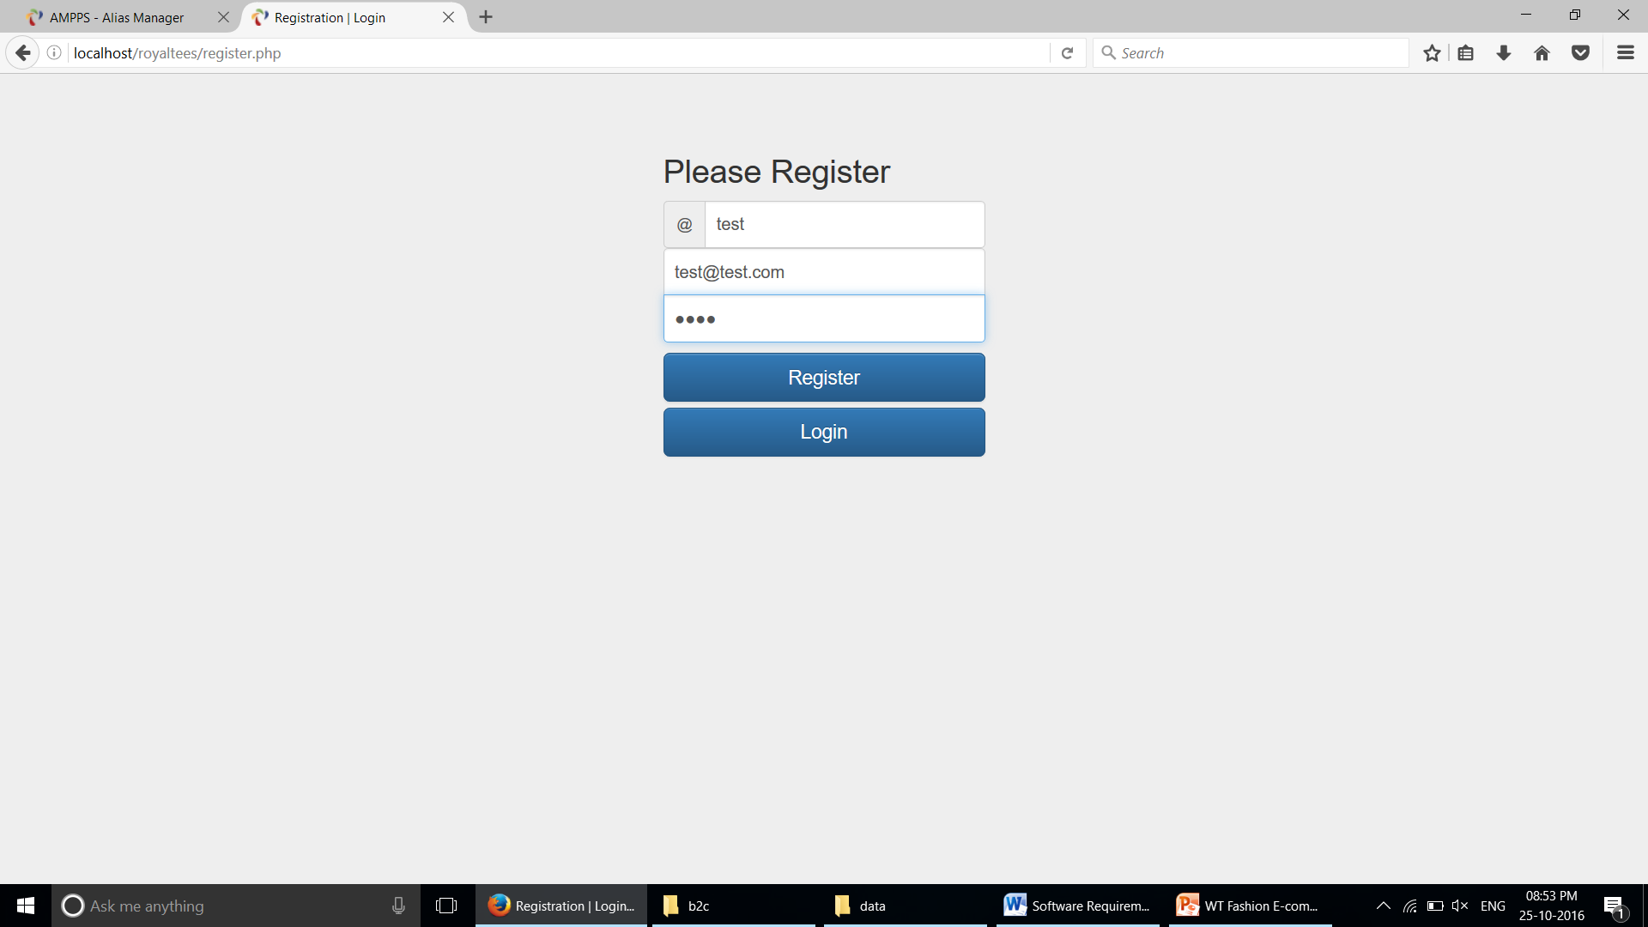
Website design - REGISTER

Slide 15
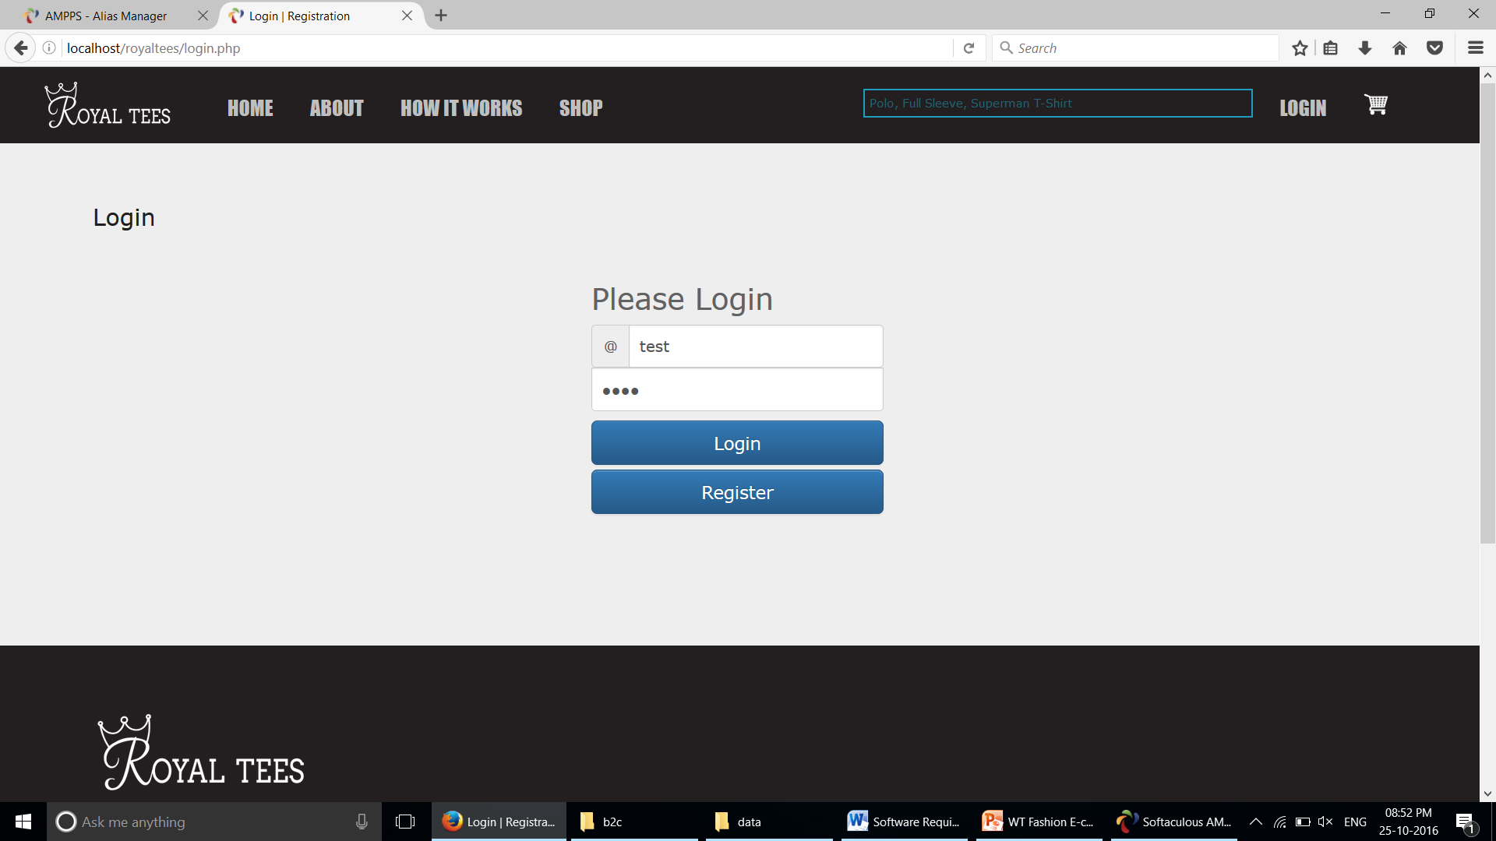
Website design - LOGIN

Slide 16
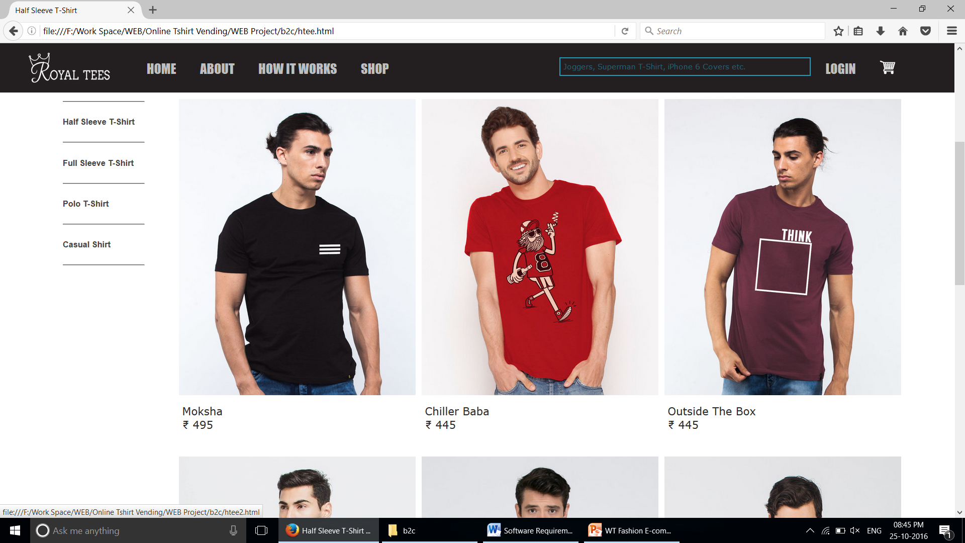
Website design – How to shop

Slide 17
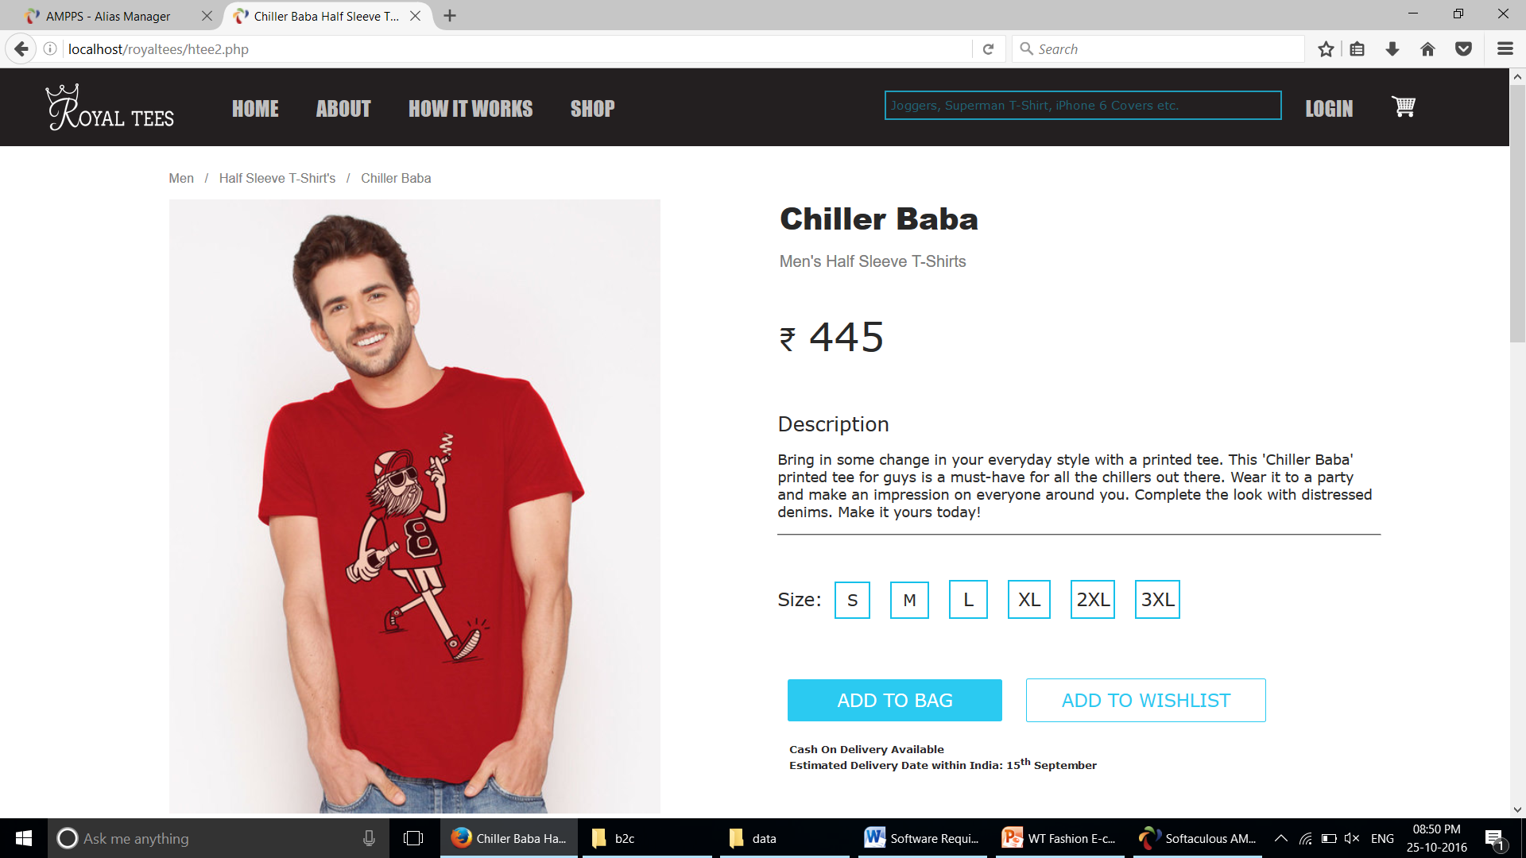
Website design – SELECTING A t-shirt

Slide 18
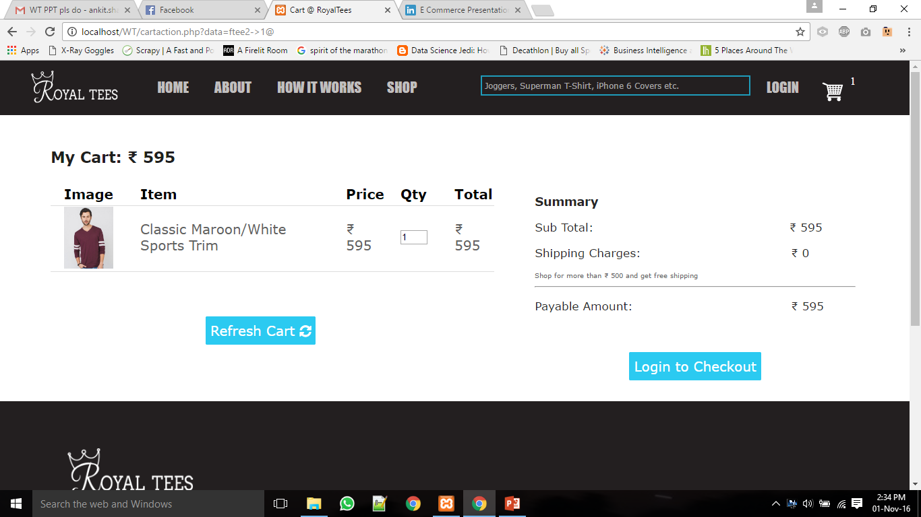
Website design – ADD TO CART

Slide 19
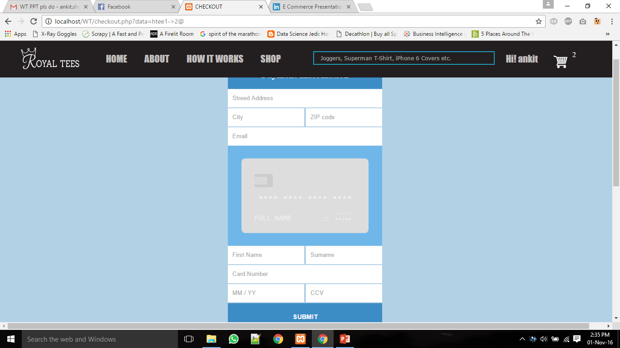
Website design – CHECKOUT

Slide 20
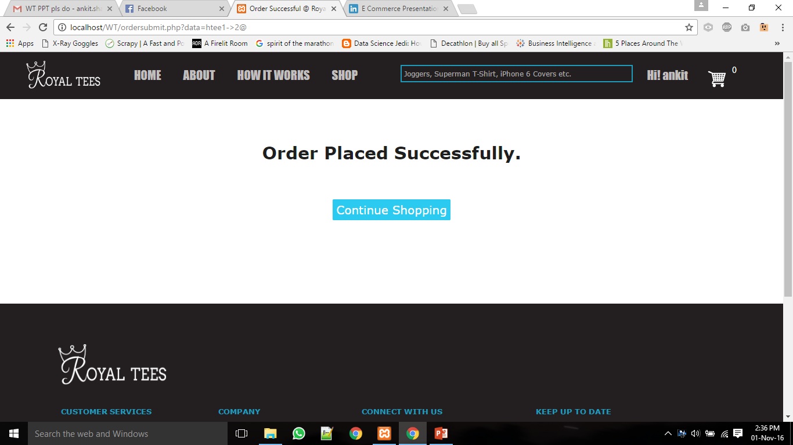
Order Submit Successfully

Slide 21
Thank you…

